Slide 1
11-364 Presentation Grid search
Jineet Doshi
Brownlee 9
2/8/2017

Slide 2
Hyper-parameters to tune
Weight initialization techniques
(Gaussian distribution, uniform, random)?
Learning rate η
(slow learning vs overshooting convergence)
Mini batch size M
(suboptimal updates to weights in Stochastic Gradient Descent vs CPU power)

Slide 3
Regularization parameter λ
(curve smoothing vs overfitting)
Number of neurons in a layer
(accuracy vs performance)
Number of epochs
(accuracy vs CPU power, time)
Dropout rate
(accuracy vs overfitting)
Parameter tuning is extremely important for ANY machine learning model!

Slide 4

Image courtesy: http://www.3hatscommunications.com/2016/choices-wordpress/

Slide 5
Grid Search to the rescue!
Special package in scikit-learn library (GridSearchCV)
Provides accuracy rates for every possible combination of the hyper parameter values provided.
Implementation: Define the range of each hyper parameter in a python dictionary and pass it to a GridSearchCV model.
Useful for all machine learning algorithms. Not just Deep Learning.
Integrates well with Keras running on Theano or Tensorflow.

Slide 6
Experiment performed:
Pima Indians Diabetes Dataset: 768 samples
8 Features:
1. Number of times pregnant
2. Plasma glucose concentration a 2 hours in an oral glucose tolerance test
3. Diastolic blood pressure
4. Triceps skin fold thickness
5. 2-Hour serum insulin
6. Body mass index
7. Diabetes pedigree function
8. Age
Task: Classify whether diabetes present or not

Slide 7
Experiment performed:
Stack:
Scikit
learn
Keras
Theano

Slide 8
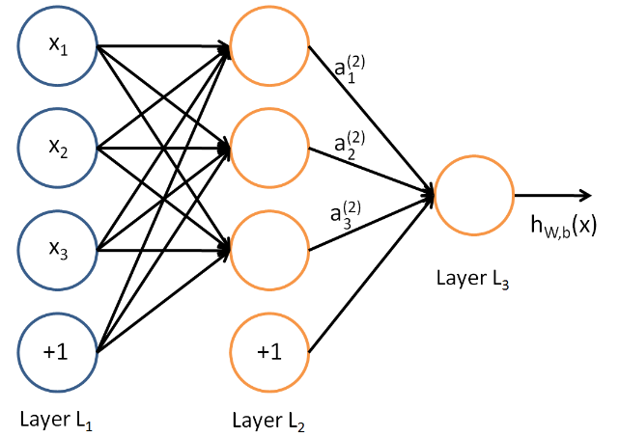
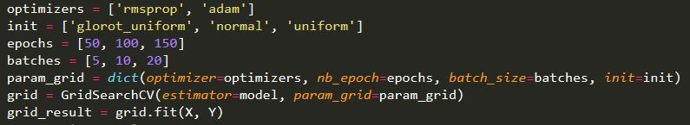
Experiment performed:
Network (hidden layer with 8 neurons):
Code written for GridSearch:

Slide 9
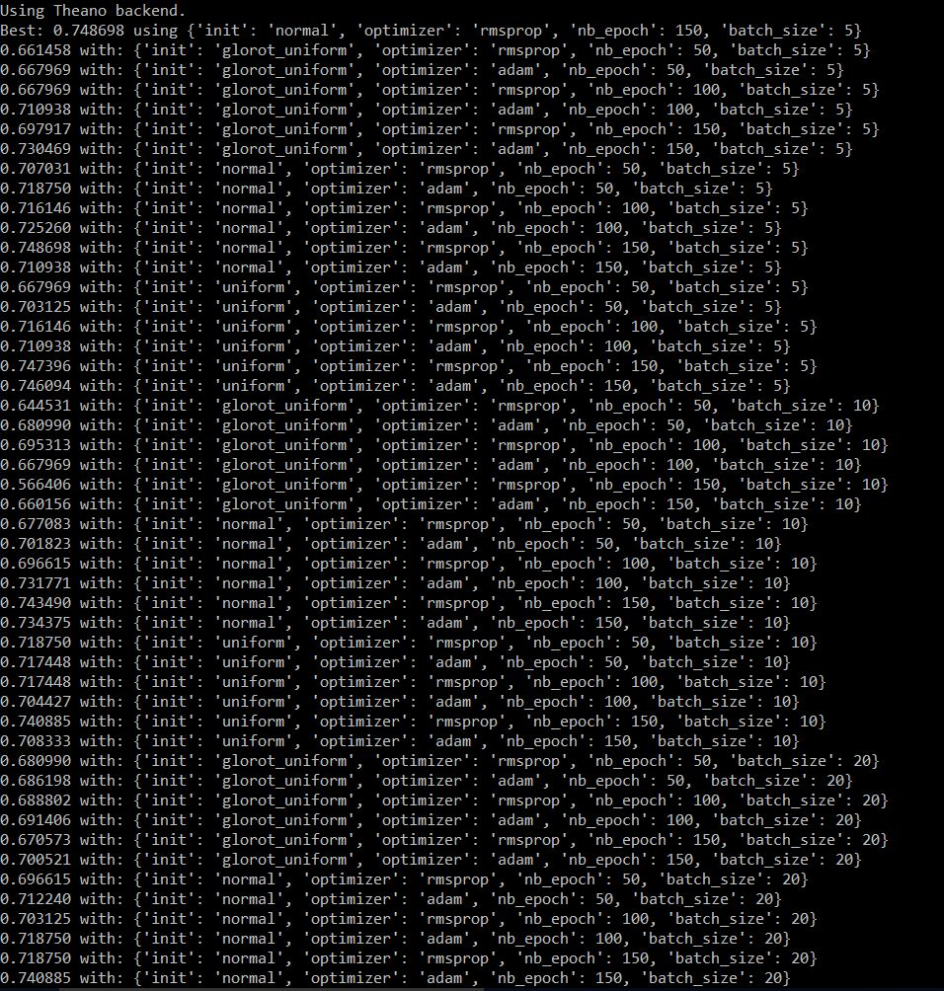
Experiment performed:
Results (screenshot from my terminal):
Best: 75% accuracy with weight initializations = Gaussian, Optimizer = rmsprop,
Epochs = 150, Batch size = 5

Slide 10
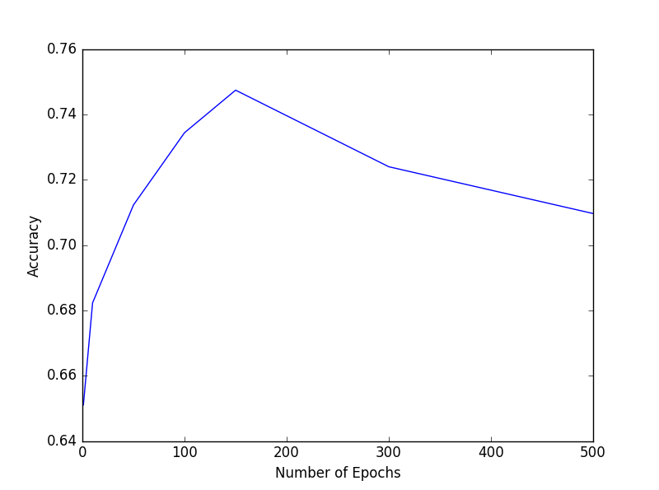
Experiment performed:
Effect of number of epochs on accuracy
Plot using Matplotlib

Slide 11
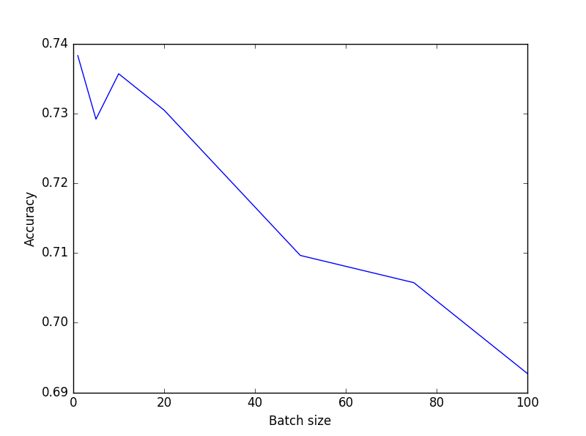
Experiment performed:
Effect of mini batch size on accuracy
Plot using Matplotlib

Slide 12
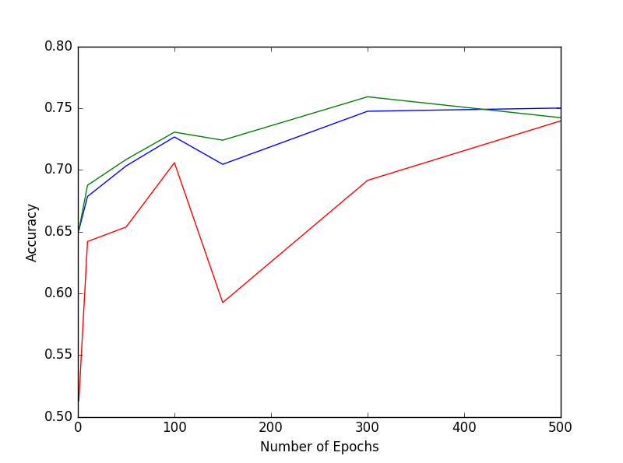
Experiment performed:
Effect of weight initializations on accuracy
Red – Glorot uniform
Blue – Normal
Green - Uniform
Plot using Matplotlib

Slide 13
Warning!
For every combination of the hyper parameter values, Grid Search generates a new model and tests accuracy using 3 fold cross validation.
Hence, if training data is large or number of parameters to tune are more, this can be extremely time consuming!
Make sure you have enough computing power (read: AWS instances or a supercomputer) before running Grid Search on large data or with more parameters.

Slide 14
Current research in Hyper parameter tuning
Surrogate based Optimization
http://www.jmlr.org/proceedings/papers/v28/bardenet13.pdf
Gradient based Reversible learning
https://arxiv.org/pdf/1502.03492.pdf

Slide 15
Takeaways
Hyper parameter tuning is very important for success of the model
Lot of options and limited computing power/time. GridSearch is great for datasets with less features and when less number of hyper-parameters are to be tuned. For more complex datasets or networks, more computing power is needed.
Area of active research. Lot of new ideas being proposed.

